Slide 1
Distribution and Characteristics of Large-Scale Ecosystems (Biomes)

Slide 2
What Are Biomes?
Biomes are huge ecological zones defined by climate, soil, and living things.
Each biome supports plants and animals uniquely adapted to its conditions.
Distribution of biomes depends largely on temperature and precipitation levels.
Biomes show patterns along latitude, altitude, and other geographic factors.
They help scientists categorize Earth's ecosystems for study and conservation.
Human activity is now reshaping many biomes in dramatic, harmful ways.
Understanding biomes helps us predict how climate change affects ecosystems.

Slide 3
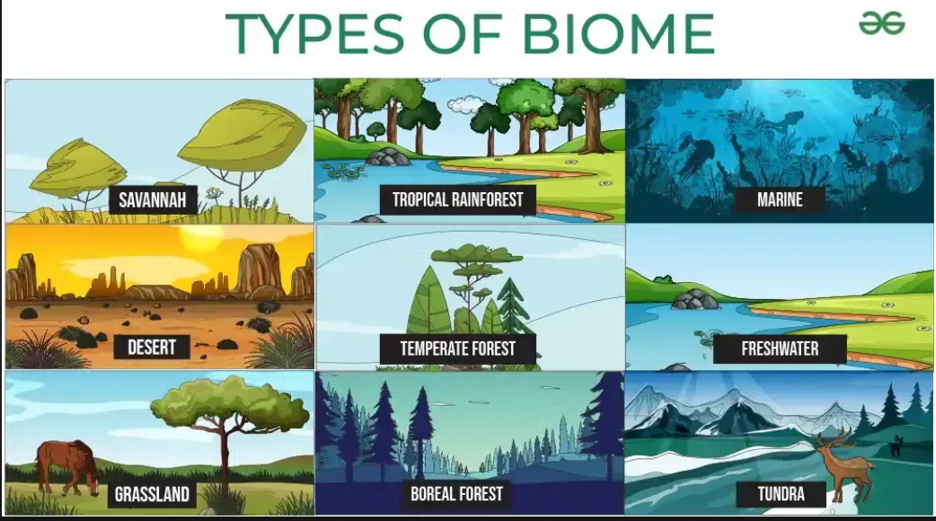

Slide 4
Major Types of Biomes
Tropical Rainforest: hot, very wet, dense tree cover, huge biodiversity.
Savanna: tropical grassland with scattered trees and seasonal rainfall.
Desert: very dry, sparse vegetation, extreme temperature variation, low rain.
Temperate Grassland: moderate rainfall, mostly grasses, few trees, fertile soils.
Temperate Deciduous Forest: four seasons, trees lose leaves in fall.
Temperate Rainforest: cooler climates, high rainfall, tall evergreen trees.
Mediterranean/Chaparral: hot dry summers, mild wet winters, shrubs dominate.

Slide 5
Major Types of Biomes
Taiga (Boreal Forest): very cold winters, evergreen coniferous forests dominate.
Tundra: cold climate, permafrost soil, only mosses and low shrubs grow.
Alpine (Mountain): high altitude, thin air, cold, specialized plant life exists.
Polar Ice Caps: covered in ice, extreme cold, little to no plant life.
Mangrove Forests: coastal wetlands, salt-tolerant trees, rich in biodiversity.
Wetlands (Swamp/Marsh): waterlogged soil, aquatic plants, important for water purification.
Desert Shrubland: semi-arid, small shrubs, occasional rain, specialized drought-tolerant life.

Slide 6
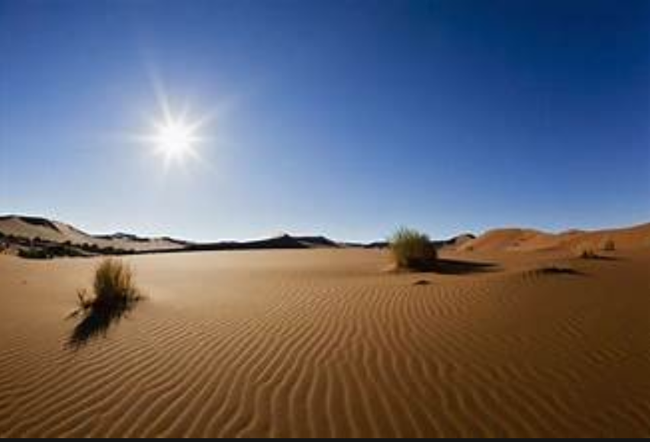

Slide 7
Global Distribution Patterns
Tropical rainforests cluster near the equator where heat and rainfall are constant.
Deserts often lie around 30° north and south latitudes due to dry air.
Temperate forests occur in mid-latitude zones with balanced seasonal climates.
Taiga spreads across broad northern regions like Canada and Russia.
Tundra appears near the poles or on high mountain tops.
Grasslands appear in continental interiors, where rainfall is neither too high nor too low.
Coastal biomes (like mangroves) are found at tropical and subtropical shorelines.

Slide 8
Characteristics of Biome Components
Climate: Temperature and rainfall patterns are crucial for biome identity.
Soil: Nutrient richness and type influence which plants can thrive in each biome.
Vegetation: Plants are adapted to their biome’s conditions (e.g., drought, cold, wet).
Animals: Fauna evolves special traits to survive in biome-specific conditions.
Energy Flow: Biomes have food chains and webs shaped by dominant plant species.
Disturbance: Fire, drought, flooding, and human activity shape biomes strongly.
Adaptation: Species adapt to their biome through physiological and behavioral traits.

Slide 9
Importance & Threats
Biomes regulate Earth’s climate by storing carbon and controlling water cycles.
They support biodiversity by providing many different habitats for species.
Ecosystem services from biomes include clean air, soil fertility, and water.
Human-driven climate change is shifting biome boundaries, altering ecosystem balance.
Deforestation and land conversion destroy biome integrity and reduce biodiversity.
Conservation efforts aim to preserve biome health through protected areas and restoration.
Understanding biomes helps people make better decisions about land use and sustainability.

Slide 10
Thank You ☺

