Slide 1
Glacial Processes Operating in the Himalayan Landscape

Slide 2
Introduction to Himalayan Glacial Systems
Himalayas hold thousands of glaciers feeding major Asian rivers like Indus and Ganges.
Glaciers form where snowfall exceeds melting, creating massive ice bodies over time.
These glaciers act as “water towers” for millions of people downstream.
Himalayan glaciers show both long-term and short-term (seasonal) changes each year.
They are highly sensitive to temperature rise and monsoon precipitation patterns.
Long-term climate variations control glacier expansion or retreat in the mountains.
Scientists monitor glacier mass balance to understand environmental and water impacts.

Slide 3
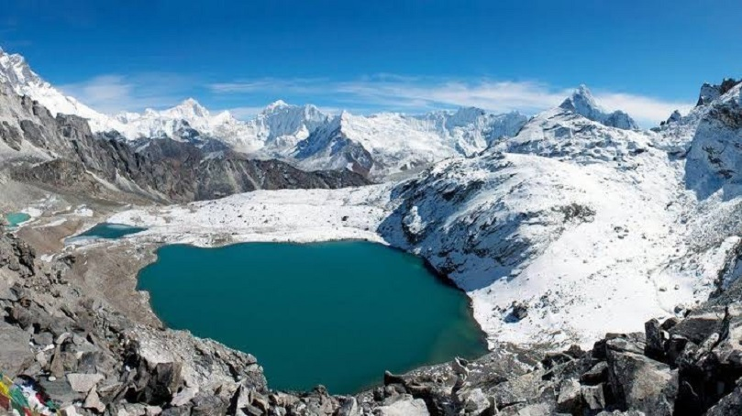

Slide 4
Glacial Accumulation Processes
Accumulation means the glacier gains mass mainly through snowfall and frozen rain.
Snow turns into ice under pressure and adds thickness to the glacier body.
Avalanches from upper slopes also contribute snow to the accumulation zone.
Accumulation mostly happens in winter when temperatures remain below freezing point.
The rate depends on elevation, slope direction, and regional climate patterns.
Thick snow layers compact slowly, forming dense glacial ice over many years.
High-altitude areas in the Himalayas remain accumulation zones throughout the year.

Slide 5
Glacial Ablation Processes
Ablation refers to the melting, evaporation, or breaking of ice from glaciers.
It mainly occurs in lower regions where temperatures rise above freezing point.
Melting forms streams that carry water to rivers during summer months.
Sunlight intensity and duration strongly affect the glacier melting rate.
Wind, debris, and rainfall also accelerate surface melting in ablation zones.
Glacial tongues retreat when ablation exceeds accumulation for several years.
Seasonal melting causes major summer floods in Himalayan river systems downstream.

Slide 6
Seasonal Glacier Changes
During winter, accumulation dominates, and glacier mass increases with heavy snowfall.
In summer, strong solar radiation causes intense melting and mass reduction.
The balance between accumulation and ablation changes with monsoon activity.
Snowline shifts upward in summer and downward during cold winter months.
Small glaciers react faster to temperature changes than larger, thicker ones.
Satellite data helps track these seasonal shifts in glacier coverage and flow.
Seasonal melting supports rivers like Indus and Ganges during dry summer seasons.

Slide 7
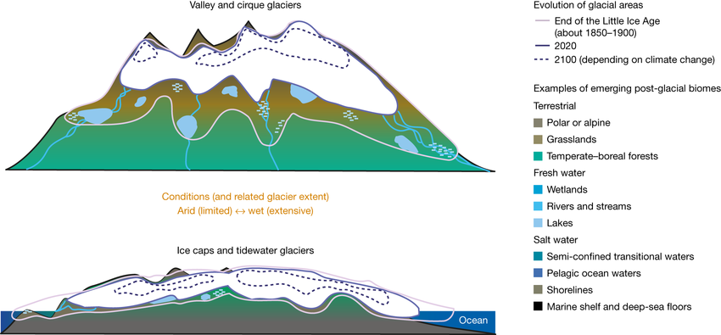

Slide 8
Long-term Glacier Changes
Over decades, global warming has caused steady retreat of many Himalayan glaciers.
Long-term retreat reduces freshwater availability for millions in South Asia.
Glacier shrinkage increases risks of glacial lake outburst floods (GLOFs).
Rising temperatures shift snowlines upward, shrinking accumulation zones rapidly.
Historical photos show dramatic glacier shortening since mid-twentieth century.
Long-term changes affect river flow timing, agriculture, and hydroelectric power generation.
Conservation efforts focus on monitoring glaciers using drones and satellite technologies.

Slide 9
Importance and Future Concerns
Glaciers regulate water flow, ensuring year-round supply to rivers and communities.
Their seasonal melting sustains agriculture and drinking water in mountain regions.
Rapid melting threatens water security for countries like Pakistan, India, and Nepal.
Climate change increases unpredictability in rainfall and glacier melt rates.
Loss of glaciers disrupts ecosystems and natural habitats in mountain environments.
Scientists urge global cooperation to reduce emissions and slow glacier retreat.
Protecting glaciers ensures stable future for people relying on Himalayan rivers.

Slide 10
Thank You ☺

