Slide 1
Pakistan's Natural Wealth: Water and Mineral Resources

Slide 2
Pakistan's Vital Resources: Water and Minerals
Water is Pakistan's most critical natural resource, essential for agriculture and survival.
The Indus River System forms the backbone, supporting livelihoods across the vast country.
Mineral resources, though largely untapped, offer immense potential for economic diversification.
Balochistan and Khyber Pakhtunkhwa are key provinces containing significant mineral deposits.
Sustainable management of these two crucial resources is fundamental for national stability.
Growing population, climate change, and weak infrastructure pose serious management challenges.
This lecture will explore how these vital resources are currently distributed and exploited.

Slide 3
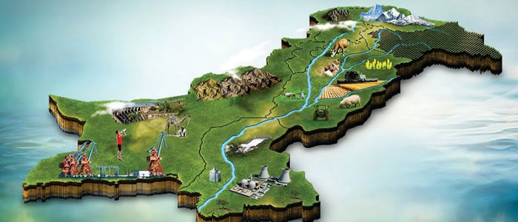

Slide 4
Water Resource Distribution
The majestic Indus River and its main tributaries provide almost all of Pakistan’s water.
Glacial melt from the Karakoram and Himalayan ranges is the major source of river flow.
Water availability is highest in the northern areas and lowest in the arid southern regions.
Extensive canal networks irrigate the fertile plains, creating the world's largest contiguous system.
Groundwater resources are widely distributed but are being rapidly depleted across provinces.
Uneven rainfall patterns and seasonal changes create periods of both floods and severe droughts.
Inter-provincial water sharing is governed by the 1991 Water Apportionment Accord, ensuring distribution.

Slide 5
Water Resource Exploitation
Agriculture consumes approximately ninety percent of the country's total available fresh water supply.
Exploitation focuses on large dam construction for generating hydropower and water storage capacity.
Tarbela and Mangla Dams are prime examples, providing electricity and irrigation water consistently.
Widespread inefficient irrigation practices, like flood irrigation, result in massive water wastage.
Industrial and municipal sectors exploit smaller amounts, but often contribute to serious water pollution.
Groundwater extraction through tube wells is unregulated, leading to significant aquifer depletion everywhere.
Urgent focus is now required on efficient water-saving technologies and modern infrastructure development.

Slide 6
Mineral Resource Distribution
Pakistan possesses substantial reserves of coal, copper, gold, rock salt, and chromite deposits.
Significant high-quality rock salt deposits are found in the Salt Range of Punjab province readily.
The vast Thar Desert in Sindh holds one of the world's largest untapped reserves of coal quickly.
Balochistan is rich in metallic minerals, including Reko Diq's enormous copper and gold reserves.
Limestone and gypsum are distributed widely, forming the foundation for the crucial construction industry.
Natural gas and petroleum reserves are generally concentrated in Sindh and Balochistan provinces mostly.
Distribution is geographically uneven, necessitating effective, balanced policies for regional development.

Slide 7
Mineral Resource Exploitation
Coal is primarily exploited for energy generation, with major projects focused on the Thar coalfield development.
Exploitation is hampered by a lack of modern technology, capital investment, and skilled technical labor.
The mining sector faces significant security challenges and complex legal ownership issues in the country.
Small-scale, informal mining operations often dominate, leading to highly unsafe working conditions and environmental damage.
Foreign investment is slow due to bureaucratic hurdles and political instability impacting long-term projects.
Exports of raw, unprocessed mineral ores represent a missed opportunity for higher value-added economic growth.
The government must prioritize transparency and clear regulatory frameworks to boost resource utilization properly.

Slide 8
Conclusion and Way Forward
Efficient water management is paramount, requiring political consensus on national storage solutions and better practices.
Addressing climate change's impact on glacial melt and monsoon intensity is critical for resource planning.
Mineral exploitation must prioritize local communities' welfare and strict adherence to modern environmental standards.
Technology transfer and skills development are crucial for transforming the outdated, inefficient mining sector operations.
Investment in developing downstream industries will maximize the economic benefits derived from raw materials.
Better resource governance, coordination between federal and provincial bodies, is essential for progress successfully.
Responsible, equitable, and efficient use of water and minerals will ensure Pakistan's long-term prosperity and stability.

Slide 9
Thank You ☺

