Slide 1
Relief, Drainage and Hydro-Meteorological Hazards of Pakistan

Slide 2
Relief and Drainage of Pakistan
Pakistan’s land has mountains, plateaus, plains, deserts, and coastal areas.
Northern mountains include Himalayas, Karakoram, and Hindu Kush mountain ranges.
Western mountains cover Balochistan plateau and dry rugged terrain regions.
Indus Plain stretches from north to south, formed by river deposits over centuries.
Thar Desert lies in the southeast, mostly sandy with scarce rainfall and vegetation.
Coastal areas stretch along the Arabian Sea with sandy beaches and mangrove forests.
The relief affects population distribution, agriculture, and natural hazard occurrence across Pakistan.

Slide 3
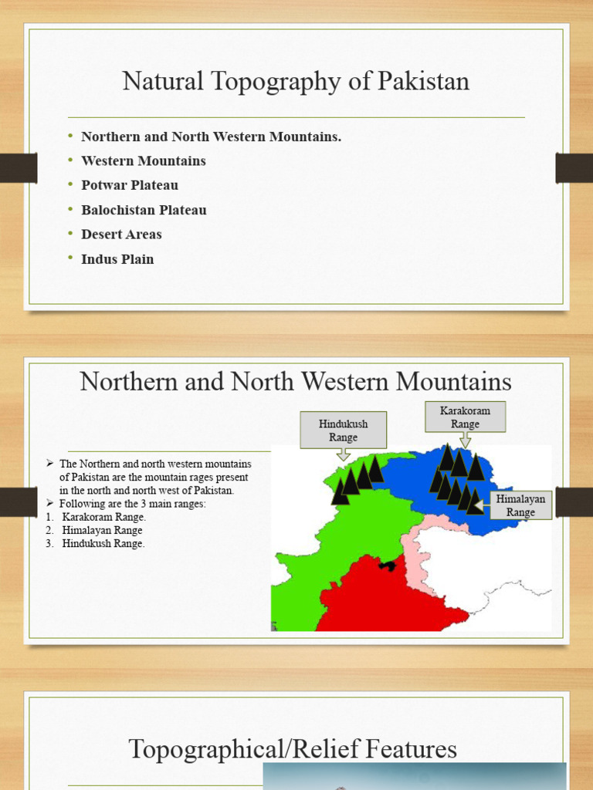

Slide 4
The Indus River System Overview
The Indus River is Pakistan’s lifeline, flowing from Tibet through entire country.
It starts in the Himalayas and enters Pakistan through Gilgit-Baltistan mountainous region.
Major tributaries include Jhelum, Chenab, Ravi, Beas, and Sutlej Rivers.
These rivers form the Indus Basin, supporting agriculture, industry, and hydroelectric power.
River water is managed by dams like Tarbela and Mangla for irrigation control.
Indus River finally flows into the Arabian Sea forming wide deltaic coastline.
Floods along the Indus are common during summer monsoon and glacier melting.

Slide 5
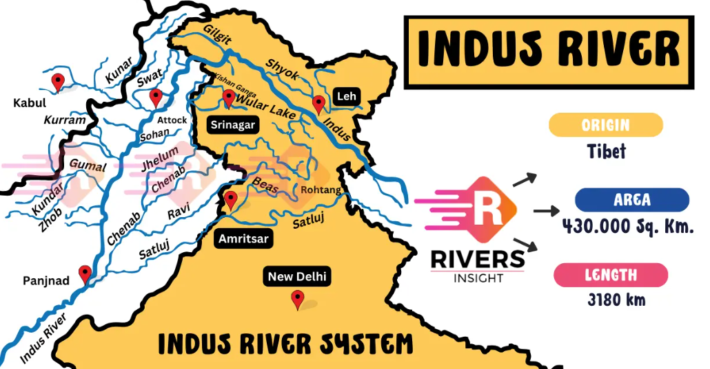

Slide 6
The Jhelum River and Its Drainage Features
The Jhelum River originates from Indian-administered Kashmir near Verinag Spring source.
It flows through hilly areas and joins Chenab River near Trimmu in Punjab.
The river passes through important cities like Muzaffarabad and Mangla region.
Mangla Dam built on Jhelum provides irrigation water and hydroelectric energy production.
Floods occur during heavy rains and glacier melting in northern highlands every year.
Jhelum’s basin supports fertile farmlands and dense rural settlements along its banks.
The river plays major role in Punjab’s agriculture and canal irrigation system.

Slide 7
Chenab, Ravi and Sutlej Floodplains
Chenab River joins Ravi and Sutlej, forming rich fertile floodplains in Punjab.
These plains are called “Doabs” meaning lands between two major rivers.
Floodplains receive fertile alluvial soil deposits during annual monsoon flooding periods.
Major crops grown include wheat, cotton, rice, and sugarcane in productive lands.
Floods sometimes destroy crops and houses but also replenish soil fertility naturally.
Embankments and barrages regulate river flow reducing flood risks and irrigation shortages.
The plains support dense population and major agricultural settlements in central Pakistan.

Slide 8
The Indus Deltaic Coastline
Indus River ends at Arabian Sea forming wide delta with distributary channels.
The Indus Delta covers Sindh coastal areas with mangroves and mudflats ecosystems.
It provides breeding ground for fish, shrimp, and many aquatic species regionally.
Reduction in river flow causes delta shrinkage, salinity, and loss of biodiversity.
Karachi and Thatta face coastal erosion and sea-level rise threats frequently.
Cyclones from Arabian Sea often hit delta region causing flooding and property damage.
Delta management requires better water sharing and mangrove restoration environmental efforts.

Slide 9
Hydro-Meteorological Hazards in Pakistan
Hydro-meteorological hazards include floods, droughts, cyclones, and heavy monsoon rainfall events.
Riverine floods mainly occur along Indus and its tributaries during monsoon season.
Flash floods affect hilly northern regions due to glacier melt and cloudburst rains.
Droughts mostly hit Balochistan and Thar Desert due to low and irregular rainfall.
Cyclones and coastal flooding affect Sindh and Makran coasts during tropical disturbances.
Climate change increasing glacier melting and irregular rain patterns intensify hazard impacts.
Disaster preparedness, early warnings, and afforestation help reduce these hazards’ impacts.

